Slide 1

Compiler Design
Preet Kanwal
Department of Computer Science & Engineering
Teaching Assistant : Kavya P K

Slide 2

Compiler Design
Unit 4: Three-Address Code
Preet Kanwal
Department of Computer Science & Engineering

Slide 3
Compiler Design Lecture Overview
In this lecture, you will learn about -
Data Structures for Three-Address Code
Quadruples
Triples
Indirect Triples
Example Questions

Slide 4
Compiler Design
Data Structures for TAC
Three address code is represented as a record structure with fields for operator and operands.
These records can be stored as an array or a linked list.
There three types of record structures -
Quadruples [4 fields]
Triples [3 fields]
Indirect Triples [Triples + List of pointers to Triples]

Slide 5
Compiler Design Quadruples
A Quadruple is an array type data structure with 4 fields -
where,
op - operator.
arg1, arg2 - the two operands used. result - the result of the expression.

Slide 6
Compiler Design Quadruples
arg1, arg2 and result are pointers to symbol table entries.
This means even temporaries must be placed in symbol table as they are created.
Any unused field is left blank/NULL
Disadvantage - Temporary names have to be entered into symbol table.

Slide 7
Compiler Design
Quadruples Format - Unary Operators
The given table describes the quadruple format for unary operators -
Statement | op | arg1 | arg2 | result
Unary operators - arg2 is empty | op | arg1 |  | arg2
Example: x=-y | - | y |  | x
Example: x=y | = | y |  | x
Notes:
,,,,,,,,,,,,,,,,,,,,,,,,,,,,,,,,,,,,,,,, ,

Slide 8
Compiler Design
Quadruples Format - Functions
The given table describes the quadruple format for functions -
Statement | op | arg1 | arg2 | result
param operator - arg2 and result are empty | param | arg1
Example: param x | param | x
Function Call - call func_name, func_param | call | func_name | value | x
Example: call foo,3 | call | foo | 3
Example: x = call foo,3 | call | foo | 3 | x

Slide 9
Compiler Design Quadruples Format - Jumps
The given table describes the quadruple format for jumps -
Statement | op | arg1 | arg2 | result
For unconditional jumps - result is label | goto |  |  | label
conditional jump Example - if x goto L | if | x |  | L
conditional jump Example - ifFalse x goto L | ifFalse | x |  | L

Slide 10
Compiler Design
Quadruples Format - Labels and return
The given table describes the quadruple format for labels and return statements -
Statement | op | arg1 | arg2 | result
Label generation Example - L1: | Label |  |  | L1
return | return | x
return x | return | x

Slide 11
Compiler Design
Quadruples Format - Array indexing
The given table describes the quadruple format for array indexing -
Statement | op | arg1 | arg2 | result
x[i] = y | []= | x | i | y
 | STAR | x | i | y
x = y[i] | =[] | y | i | x
 | LDAR | y | i | x
STAR = STORE ADDRESS
LDAR = LOAD ADDRESS

Slide 12
Compiler Design Exercise 1
Write the Three-Address Code and corresponding Quadruple representation for the following code snippet -
if x == 0
u = 1;
else
u = fact(x – 1) * x; fact = u;

Slide 13
Compiler Design Exercise 1 - Solution
t1 = x == 0
ifFalse t1 goto L1 u = 1
goto L2 L1:
t2 = x – 1 param t2
t3 = call fact, 1 t4 = t3 * x
u = t4 L2:
fact = u
Three-Address Code - if x == 0
u = 1;
else
u = fact(x – 1) * x; fact = u;

Slide 14
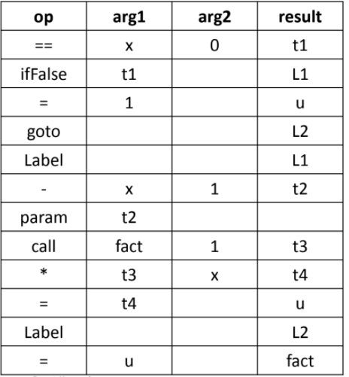
Compiler Design Exercise 1 - Solution
Quadruple - t1 = x == 0
ifFalse t1 goto L1 u = 1
goto L2 L1:
t2 = x – 1 param t2
t3 = call fact, 1 t4 = t3 * x
u = t4 L2:
fact = u

Slide 15

Compiler Design Triples
A Triple is an array type data structure with 3 fields -
where,
op - operator.
arg1, arg2 - the two operands used.

Slide 16
Compiler Design Triples
Triples are alternative ways for representing syntax tree or Directed acyclic graph.
Triples avoid entering temporary names into symbol table.
For a temporary, use serial number of statement computing its value.
Problem: Code Immovability
No temporary variables stored in symbol table
All references are only to the position of statement and not location.
This requires the compiler to change all references to arg1 and arg2.
Thus, triples are not very efficient in optimizing compilers.

Slide 17
Compiler Design
Triples Format - Jumps and Label
The given table describes the triple format for jumps and label -
Statement | op | arg1 | arg2
Unconditional jumps | goto | (2)
conditional jump Example - if x goto L | if | x | (2)
conditional jump Example - ifFalse x goto L | ifFalse | x | (2)
Label | Label

Slide 18
Compiler Design
Triples Format - Array indexing
The given table describes the triple format for array indexing -
Statement | Stmt no. | op | arg1 | arg2
x[i] = y | (0) | []= | x | i
 | (1) | = | (0) | y
x = y[i] | (0) | =[] | y | i
 | (1) | = | x | (0)

Slide 19
Compiler Design Exercise 2
Write the Triple representation for the following Three-Address Code -
t1 = -b
t2 = t1 * d t3 = t2 + c t4 = -b
t5 = t4 * d t6 = t3 +t5 a = t6

Slide 20
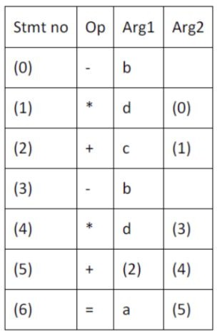
Compiler Design Exercise 2 - Solution
t1 = -b
t2 = t1 * d t3 = t2 + c t4 = -b
t5 = t4 * d t6 = t3 +t5 a = t6
The value of a temporary variable can be accessed by the position of the statement that computes it.

Slide 21
Compiler Design Indirect Triples
A separate list of pointers to the triple structure (i.e, statement numbers) is maintained.
The statements can be moved by reordering the statement list.
The utility of indirect triples is almost the same as that of quadruples, but requires less space.

Slide 22
Compiler Design Exercise 2 (cont.)
Write the Indirect Triple representation for the following Three-Address Code -
t1 = -b
t2 = t1 * d t3 = t1 + c t4 = -b
t5 = t4 * d t6 = t3 +t5 a = t6

Slide 23
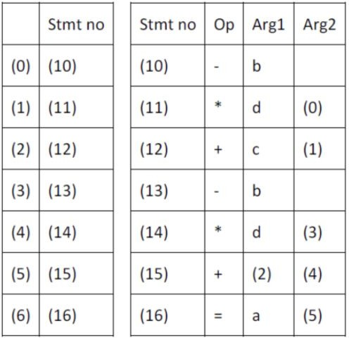
Compiler Design Exercise 2 (cont.)
t1 = -b
t2 = t1 * d
t3 = t1 + c t4 = -b
t5 = t4 * d t6 = t3 +t5 a = t6
No change in the Structure

Slide 24
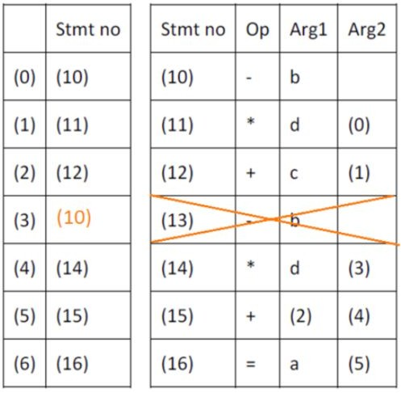
Compiler Design
Advantage of Indirect Triples
Suppose the code changes to -
t1 = -b
t2 = t1 * d t3 = t1 + c t5 = t1 * d t6 = t3 +t5 a = t6
No change in the Structure

Slide 25
Compiler Design Exercise 3
Write the Quadruple and Triple representation for the following code snippets -
1) a = b[i] + c[j] 2) x = f(y + 1) + 2
3) X[i] = a * c + y[i] – n[j] / v 4) for(j=0; j<=10; j++)
{
a = a * (j* (b/c));
}

Slide 26
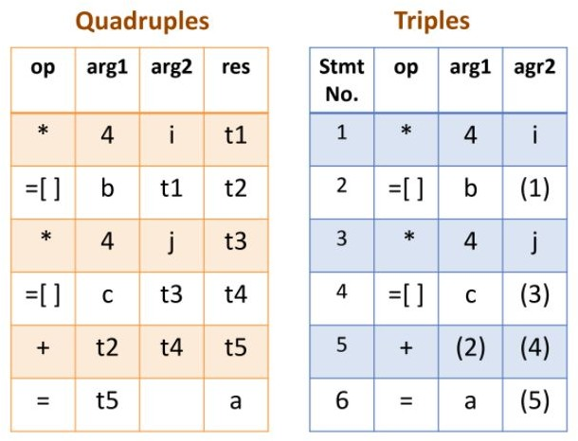
Compiler Design Exercise 3 - Solutions
1) a = b[i] + c[j] Intermediate Code -
t1 = 4 * i t2 = b[t1] t3 = 4 * j t4 = c[t3] t5 = t2 + t4 a = t5

Slide 27
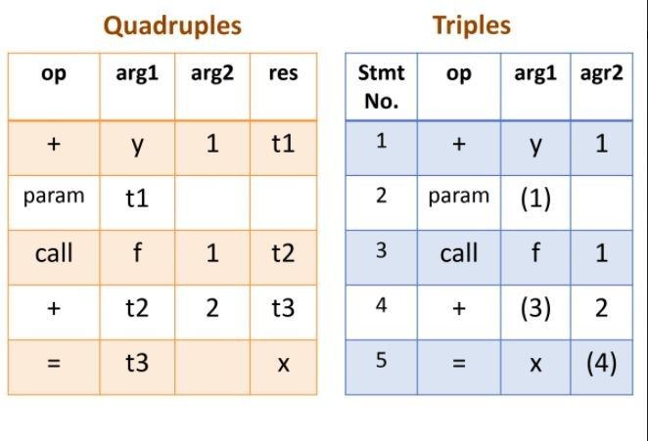
Compiler Design Exercise 3 - Solutions
2) x = f(y + 1) + 2
Intermediate code -
t1 = y + 1 param t1
t2 = call (f, 1) t3 = t2 + 2
x = t3

Slide 28
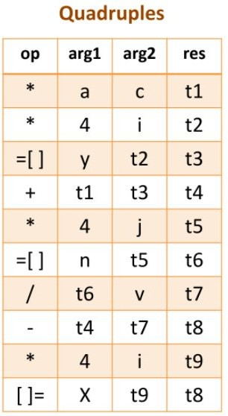
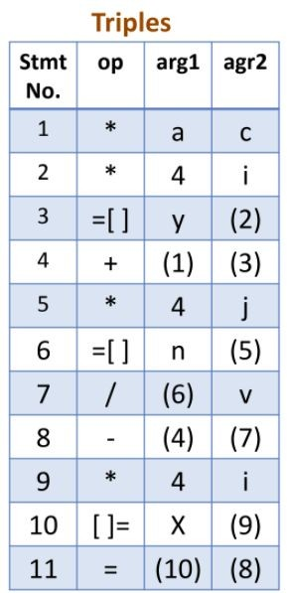
Compiler Design Exercise 3 - Solutions
3) X[i] = a * c + y[i] – n[j] / v Intermediate code -
t1 = a * c t2 = 4 * i t3 = y[t2] t4 = t1 + t3 t5 = 4 * j t6 = n[t5] t7 = t6 / v t8 = t4 – t7 t9 = 4 * i X[t9] = t8

Slide 29
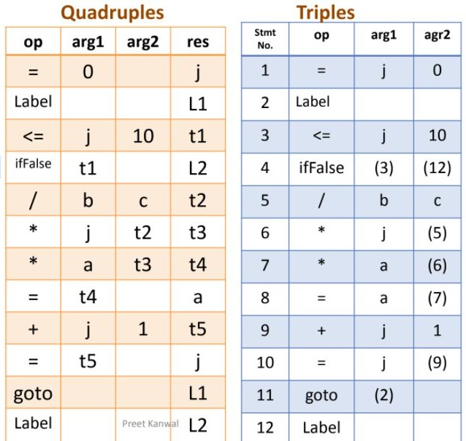
Compiler Design Exercise 3 - Solutions
4) for(j=0; j<=10; j++){ a = a * (j* (b/c));} j = 0
L1:
t1 = j <= 10
ifFalse t1 goto L2 t2 = b / c
t3 = j * t2 t4 = a * t3 a = t4
t5 = j + 1 j = t5 goto L1 L2 :

Slide 30

THANK YOU
Preet Kanwal
Department of Computer Science & Engineering
preetkanwal@pes.edu

